Slide 1
Issues in Modern Federalism
Those Anti-Federalists Just Won’t Give Up
Notes:
Created by Bob Fenster, Hillsborough High School, Hillsborough, NJ

Slide 2
Federal vs. State
Poor (or irresponsible) states may not take care of problems
Ability to level playing field between states with grants
States should be at least partly responsible for helping their own people
Laboratories for policy experiments
One size doesn’t fit all -- states know what their people need
Underfunded mandates from national government are unwelcome

Slide 3
Your Mission
In 25 minutes review the hyperlinked page(s) and/or search the Internet to be able to:
Explain how your issue creates a conflict between the national and state governments.
Argue whether you believe it should be (a) wholly a national issue, (b) entirely a state issue, or (c) a mix of the two.

Slide 4
Health Care (2)
Affordable Care Act
Mandate
Pre-existing conditions
Young people to 26 years of age
Medicaid funding
State Children’s Health Insurance Program

Slide 5
Immigration (2)
Border security
Sanctuary cities
Immigration enforcement
Racial profiling (Arizona SB1070)

Slide 6
Infrastructure (2)
Roads, bridges, water, the grid
Federal vs. state/local
Public vs. private

Slide 7
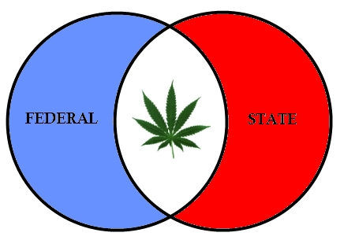
Drugs (2)
Marijuana - medicinal, recreational, clinics
Opioid crisis
Rehabilitation and education

Slide 8
Guns (2)
Background checks
Concealed carry
Assault weapons
School shootings

Slide 9
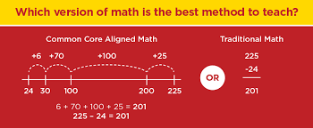
Education (2)
Elementary and Secondary Education Act
No Child Left Behind
Race to the Top & Common Core

Slide 10
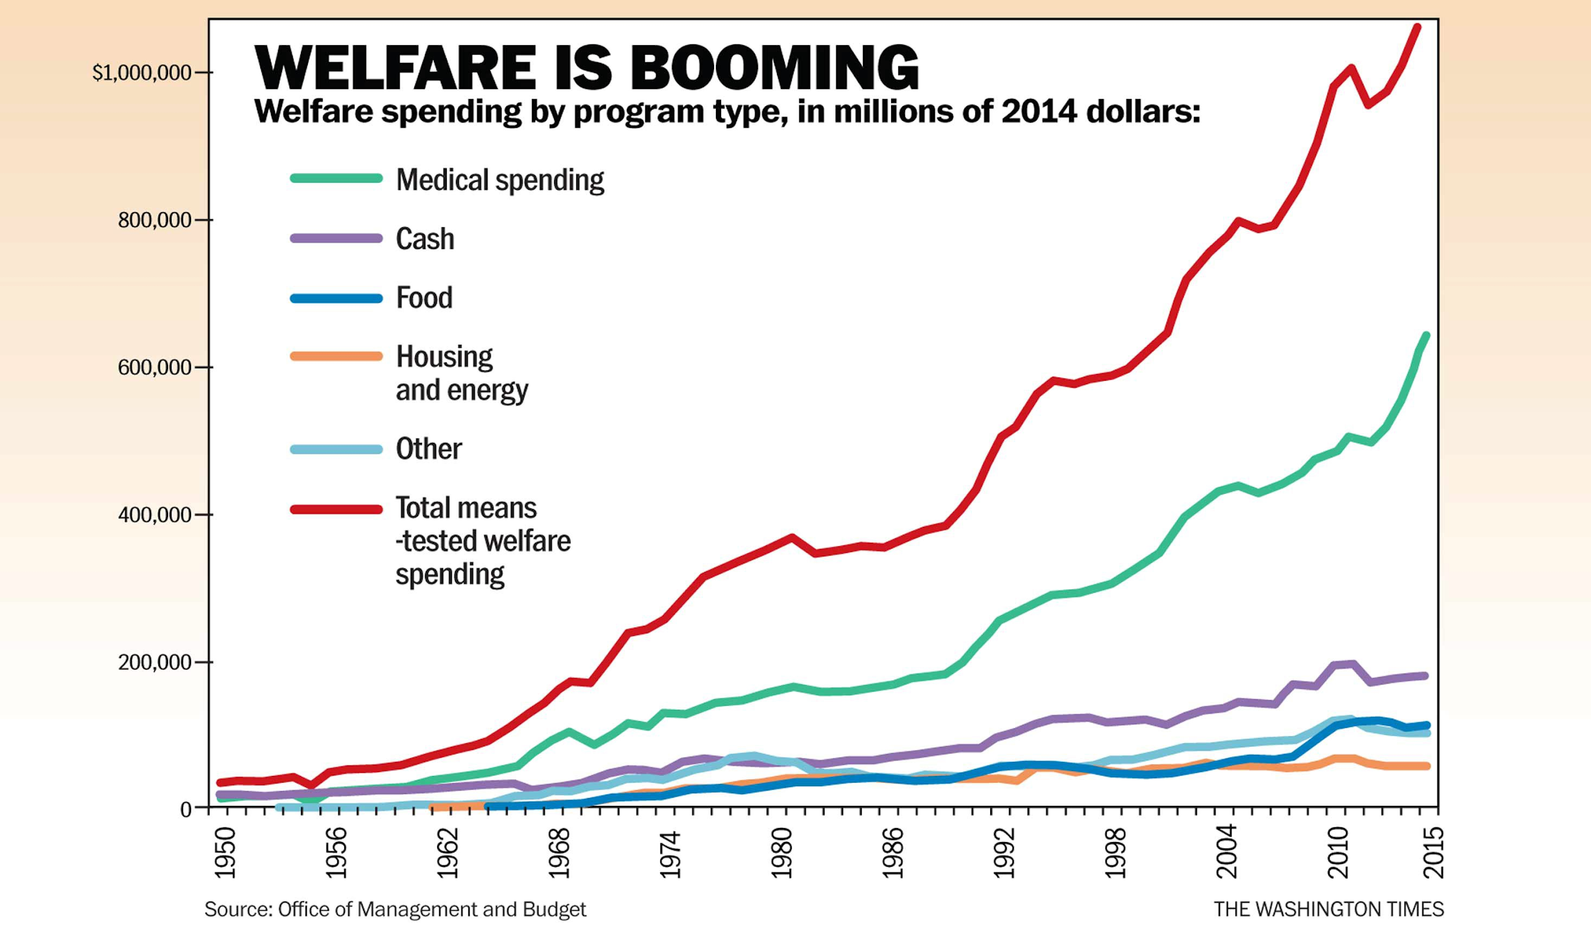
Poverty (2)
Aid to Families with Dependent Children
Temporary Assistance to Needy Families
Workfare

Slide 11
Civil Rights (2)
Racially-motivated gerrymandering
Places of public accommodation
Black Lives Matter

Slide 12
Class Debriefing
Explain how your issue creates a conflict between the national and state governments.
Argue whether you believe it should be (a) wholly a national issue, (b) entirely a state issue, or (c) a mix of the two.

Slide 13
Varying Levels of State Aid
Review some of the data on this site.
How does our state fare? Is that fair?
Why do some states get more aid than others?
Is it hypocritical to call for states’ rights but simultaneously accepting large payouts from the federal government? Why or why not?

